Slide 1
Active Directory
Penetration Testing & Red Teaming

Slide 2
Me
Soheil Hashemi
Red Teamer | Penetration Tester
@soheilsec

Slide 3

What is the Active Directory?
Directory service developed by Microsoft to manage windows domain networks.
Stores information related to objects, such as Computers, Users, Printers, etc.
Authenticates using Kerberos tickets.
Non-Windows devices, such as Linux machines, firewalls, etc. can also authenticate to AD via Radius or LDAP.

Slide 4
As Pentester or Red Teamer Things you should know about AD
AD is the most used identity management service in world 95% of Fortune 1000 companies implement the service in their networks.
can be exploited without ever attacking patchable exploit.
Instead, we abuse features, trusts, components, and more.

Slide 5
AD DS Data Stores
the ADDS data store contains the database files and processes that store and manage directory information for users, services, and applications.
The ADDS data store:
consists of the Ntds.dit file
Is stored by default in the %systemRoot%\NTDS folder on all domain controllers
Is accessible only through domain controller process and protocols

Slide 6
Logical AD components
Defines every type of object that can be stored in the directory
Enforces rules regarding object creation and configuration.
Class object | what object can be created in the directory | User, computer
Attribute Object | Information that can be attached on object | Display Name

Slide 7
Logical AD components
Schema
Forest
Tree
Domain
Child Domain
Global Catalog
Organizational Unit (OU)
Groups
Users and Computers
Resources (Files, Printers, etc.)

Slide 8
Schema
The Schema is the blueprint for Active Directory. It defines objects and attributes for all other elements within the directory (e.g., users, computers, groups).
Every AD forest has only one schema, which all domains within that forest share.

Slide 9
Forests
The Forest is the top-level AD container, representing the boundary of an AD instance. It is a collection of one or more AD domains that share the same schema and global catalog.
All domains in a forest have transitive trust relationships with each other.
A forest is a collection of one or more domain trees.
- Share a common schema
- Share a common configuration partition
- Share a common global catalog to enable searching
- Enable trust between all domains in the forest
- Share the Enterprise Admins and Schema Admins groups

Slide 10
Trees
Within a forest, you can have multiple Trees. A tree is a hierarchy of domains within a single namespace.
A domain trees is a hierarchy of domains in ADDS
All domains in the tree:
- share a contiguous namespace with the parent domain.
- Can have additional child domains.
- By default create a two-way transitive trust with other domains

Slide 11
Domains
A Domain is the primary organizational unit in AD, which is also a security boundary. It includes user, group, and computer accounts within that specific domain.
Domains within a forest have trusts established, allowing users in one domain to access resources in another.
Domains are used to group and manage objects in an organization
soheil.lab
-An administrative boundary for applying policies to groups of objects
- A replication boundary for replicating data between domain controllers.
-An authentication and authorization boundary that providess a way to limit the scope of access to resources.

Slide 12
Child Domain
A Child Domain is a subdomain of a parent domain, forming part of the hierarchical structure within a tree.
Child domains allow better organization and delegation of administrative authority within the AD environment.

Slide 13
Global Catalog (GC)
The Global Catalog is a searchable index of all objects in the AD forest.
It contains a partial replica of every object in every domain, allowing users to find AD resources regardless of domain.
Global Catalog servers are often placed at strategic locations within the AD environment to facilitate quick access to directory data.

Slide 14
Organizational Units (Ous)
OUs are containers within a domain used to organize and manage resources like users, groups, and computers.
They allow for the delegation of administrative control and the application of Group Policy settings.
Ous are active directory containers that can contain users, groups, computers, and other OUs.
- Represent your organization hierarchically and logically
- Manage a Collection of objects in a consistent way
- Delegate permissions to administer groups of objects
- Apply policies.

Slide 15
Groups
Groups are collections of users, computers, or other groups and are used to simplify permission management.
There are two main types of groups: Security Groups (used for permissions) and Distribution Groups (used mainly for email distribution).

Slide 16
Users and Computers
Users and Computers are individual objects in AD. User accounts represent individuals or services, while computer accounts represent machines joined to the domain.

Slide 17
Resources (Files, Printers, etc.)
Resources like files, printers, and other networked devices are resources that are accessible within the AD environment. Access to these resources is typically managed via security groups and permissions.

Slide 18
Logical AD components
Sites: Sites are not part of the logical hierarchy but are a physical element of AD, used to optimize network traffic within large or geographically dispersed networks.
Trusts: Although not part of the structural hierarchy, trusts connect domains and forests, defining relationships and access permissions.

Slide 19
Objects
User :Enables network resource access for a user
InetOrgPerson : Similar to a user account and Used for compatibility with other directory services
Contacts : Used primarily to assign e-mail addresses to external users. Does not enable network access.
Groups : Used to simplify the administration of access control.
Computers : Enables authentication and auditing of computer access to resources
Printers :Used to simplify the process of locating and connecting to printers.
Shared folders :Enables users to search for shared folders based on properties

Slide 20
Security Identifiers (SID), Relative Identifiers (RID), and Globally Unique Identifiers (GUID)
SID: Unique identifier for each object.
RID: The unique portion of a SID within a domain.
GUID: A 128-bit unique identifier for AD objects.

Slide 21
Distinguished Names (DN) and User Principal Names (UPN)
DN: A unique identifier specifying an object’s position in the AD hierarchy.
UPN: A simplified login format for users soheil@soheil.lab

Slide 22
Physical Components of Active Directory
Physical components represent the infrastructure supporting AD’s functionality, including server roles, replication, and network layout, which ensure AD data is available and synchronized across locations.
Domain Controllers (DCs)
Global Catalog Servers
Sites
Subnets
Replication
Read-Only Domain Controllers (RODCs)
Flexible Single Master Operations (FSMO) Roles

Slide 23
Domain Controllers
Servers that host the AD database, handle authentication, and provide access to AD resources. Domain controllers also participate in replication within and across domains.
Host a copy of the AD DS directory store
- Provide authentication and authorization services
- Replicate updates to other domain controllers in the domain and forest
-Allow administrative access to manage user accounts and network resources

Slide 24
Global Catalog Servers
Specialized domain controllers that store a partial, read-only copy of all objects in the AD forest. They help expedite searches and logon requests across domains.

Slide 25
Sites
Logical representations of physical locations within an AD infrastructure. Sites are used to manage replication traffic and optimize authentication based on network proximity.

Slide 26
Subnets
IP ranges mapped to sites to represent physical locations more granularly, helping direct client requests to the nearest domain controller within the site.

Slide 27
Replication
The process of copying AD data between domain controllers. Replication occurs within sites (intra-site) for low latency and between sites (inter-site) on a scheduled basis to manage network traffic.

Slide 28
Read-Only Domain Controllers (RODCs)
Domain controllers that hold a read-only copy of the AD database. Used primarily in remote locations with limited security or connectivity.

Slide 29
Flexible Single Master Operations (FSMO) Roles
Special roles assigned to specific domain controllers to manage critical AD functions. These include roles like Schema Master, Domain Naming Master, RID Master, PDC Emulator, and Infrastructure Master.

Slide 30
Active Directory Services
Active Directory Domain Services (AD DS)
Active Directory Lightweight Directory Services (AD LDS)
Active Directory Federation Services (AD FS)
Active Directory Certificate Services (AD CS)
Active Directory Rights Management Services (AD RMS)
Active Directory Replication Services
Active Directory Web Services (AD WS)
Active Directory Administrative Center (ADAC)

Slide 31
Active Directory Domain Services (AD DS)
Description: AD DS is the primary AD service, providing directory services, identity management, and authentication within a domain.
Functions: AD DS stores information about users, computers, and other resources in a secure, hierarchical structure, enabling centralized management of these resources.
Usage: It’s essential for managing user logins, enforcing Group Policy, and enabling centralized control over access to resources across the network.

Slide 32
Active Directory Lightweight Directory Services (AD LDS)
Description: Also known as ADAM (Active Directory Application Mode), AD LDS is a lightweight version of AD DS without domain dependencies.
Functions: AD LDS provides directory services for applications that need a directory store but don’t require full AD DS functionality or need a domain structure.
Usage: Commonly used for applications or web services that need to store directory-based information but operate independently from a domain.

Slide 33
Active Directory Federation Services (AD FS)
Description: AD FS provides single sign-on (SSO) capabilities by enabling secure sharing of identity information across domains or organizations.
Functions: Allows users to access applications and systems across organizational boundaries using the same credentials. It supports federated identity protocols like SAML and OAuth.
Usage: Used to enable SSO for users accessing resources both within and outside the organization, commonly used for SaaS applications like Microsoft 365.

Slide 34
Active Directory Certificate Services (AD CS)
Description: AD CS is Microsoft’s public key infrastructure (PKI) solution, providing the creation, management, and validation of digital certificates.
Functions: Issues certificates that secure communications and authenticate users, computers, and devices.
Usage: Critical for secure email, VPN access, encrypted communications, and any environment where certificates are required for security.

Slide 35
Active Directory Rights Management Services (AD RMS)
Description: AD RMS provides information rights management to protect digital content, such as documents and emails, from unauthorized access and use.
Functions: It controls how content can be used, who can access it, and what actions are permitted, such as preventing document copying or forwarding.
Usage: Used to protect sensitive information by enforcing policies that govern how information can be shared and by whom.

Slide 36
Active Directory Replication Services
Description: AD Replication Services manage the synchronization of directory data between domain controllers.
Functions: Ensures consistency across domain controllers in a forest by replicating changes to AD objects and attributes.
Usage: Fundamental for maintaining data integrity across multiple domain controllers, allowing users to access updated directory data across sites and domains.

Slide 37
Active Directory Web Services (AD WS)
Description: AD WS provides a web service interface for AD, allowing applications and systems to interact with AD over HTTP and SOAP protocols.
Functions: Enables management and data retrieval from AD through web services, facilitating interoperability with other platforms.
Usage: Often used with PowerShell and other applications that need programmatic access to AD data via the web, making AD accessible across various platforms and networks.

Slide 38
Active Directory Administrative Center (ADAC)
Description: ADAC is a modern management interface for AD DS, providing enhanced features for administrative tasks.
Functions: Includes a graphical user interface (GUI) and PowerShell support for managing AD objects, enabling efficient handling of users, groups, and computers.
Usage: Primarily used by administrators to streamline and simplify AD management tasks, with better support for complex operations like fine-grained password policies and dynamic access control.

Slide 39
Trust
In Active Directory (AD), trusts are relationships established between two domains or forests that enable users in one domain to access resources in another domain, either within the same forest or across different forests. Trusts are essential in multi-domain or multi-forest environments where resources need to be shared across different administrative boundaries while maintaining security.
Key Concepts of Trusts in Active Directory
Trust Direction: Trusts are one-way (only one domain trusts another) or two-way (both domains trust each other).
Trust Transitivity: Trusts are either transitive (extend beyond the two domains involved) or non-transitive (limited to the two domains only).
Authentication Flow: Trusts allow users in one domain to authenticate and access resources in another, with the trust defining how credentials and permissions are handled across boundaries.

Slide 40
Types of Trusts in Active Directory
Parent-Child Trust
Tree-Root Trust
External Trust
Forest Trust
Shortcut Trust
Realm Trust

Slide 41
Parent-Child Trust
Description: Created automatically when a new child domain is added to an existing domain.
Direction: Two-way by default.
Transitivity: Transitive.
Usage: Used within a forest to connect a parent domain and its child domains, allowing seamless resource access throughout the domain tree.

Slide 42
Tree-Root Trust
Description: Created automatically when a new domain tree is added within the same forest.
Direction: Two-way by default.
Transitivity: Transitive.
Usage: Used to connect domains from different domain trees in the same forest, facilitating access between users and resources across different domain trees.

Slide 43
External Trust
Description: A manually created trust that connects a domain in one forest to a domain in another forest or a Windows NT 4.0 domain.
Direction: Can be one-way or two-way.
Transitivity: Non-transitive.
Usage: Useful for access between domains across different forests or with legacy Windows domains when no forest trust is possible.

Slide 44
Forest Trust
Description: A manually created trust that links two separate AD forests.
Direction: Can be one-way or two-way.
Transitivity: Transitive (within each forest but limited to the two forests involved).
Usage: Enables resource sharing between all domains in two different forests, suitable for environments with multiple forests.

Slide 45
Shortcut Trust
Description: A manually created trust that provides a shortcut path between two domains within the same forest.
Direction: Can be one-way or two-way.
Transitivity: Transitive.
Usage: Primarily used to improve performance in large forests by reducing authentication time between domains that are not directly parent-child but need frequent interactions.

Slide 46
Realm Trust
Description: A manually created trust between an AD domain and a non-Windows Kerberos realm.
Direction: Can be one-way or two-way.
Transitivity: Non-transitive.
Usage: Useful for interoperability with non-Windows environments that support Kerberos authentication, such as UNIX or Linux-based systems.

Slide 47
AD Authentication & Authorization
Kerberos Authentication Protocol :Primary AD authentication protocol |Pass-the-ticket, overpass-the-hash, Kerberoasting attacks
NTLM (NT LAN Manager) : Fallback authentication for AD | Pass-the-hash, relay attacks, downgrade attacks
LDAP (Lightweight Directory Access Protocol) :Directory access and queries |LDAP injection, clear-text transmission, weak bind attacks
OAuth 2.0 and OpenID Connect (OIDC) :Web and cloud app authentication |Token hijacking, misconfigured URIs, token reuse
SAML (Security Assertion Markup Language) :Federated authentication and SSO| Token hijacking, XML wrapping, token replay

Slide 48
Kerberos Authentication Protocol
Description: Kerberos is the primary authentication protocol in AD, using a ticket-based system to authenticate users and services securely without sending passwords over the network.
Process: Users authenticate with a Key Distribution Center (KDC), which issues a Ticket Granting Ticket (TGT). This TGT can then be used to request service tickets for accessing other resources.
Potential Vulnerabilities:
Pass-the-Ticket Attacks: Attackers can capture and reuse Kerberos tickets to impersonate users.
Overpass-the-Hash Attacks: Attackers with NTLM hash access can create fake Kerberos tickets.
Kerberoasting: Attackers request service tickets for accounts with weak passwords, then crack the encrypted passwords offline.

Slide 49
NTLM (NT LAN Manager)
Description: NTLM is an older authentication protocol used as a fallback when Kerberos is unavailable or not supported. NTLM relies on challenge-response mechanisms.
Process: The client sends a hashed version of the user's password, which the server challenges with a random value, and the client responds with a hashed response.
Potential Vulnerabilities:
Pass-the-Hash (PtH) Attacks: Attackers with access to password hashes can use them to authenticate as the user without cracking the password.
Relay Attacks: Attackers intercept and relay NTLM authentication messages to impersonate users.
Downgrade Attacks: Some systems are forced to use NTLM by attackers instead of the more secure Kerberos.

Slide 50
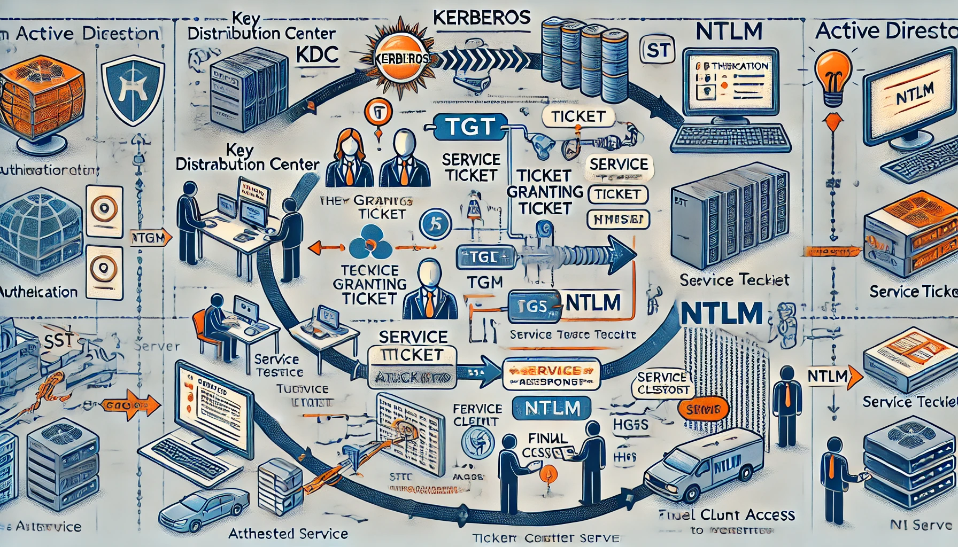
Landscape Kerberos and NTLM authentication protocols

Slide 51
Kerberos Authentication Steps
User Login and Initial Request to KDC : The user logs in and requests authentication from the Key Distribution Center (KDC) by sending their credentials to the Authentication Server (AS), which is part of the KDC.
KDC Issues Ticket Granting Ticket (TGT) : The AS verifies the user's credentials and issues a Ticket Granting Ticket (TGT). This ticket is encrypted and can only be decrypted by the KDC, ensuring security. The TGT serves as a "master ticket" for obtaining other tickets and is usually valid for a set duration.
TGT Request to the Ticket Granting Server (TGS):When the user attempts to access a specific service (like a file server), they use the TGT to request a Service Ticket from the Ticket Granting Server (TGS), also part of the KDC.
TGS Issues Service Ticket (ST):The TGS validates the TGT and issues a Service Ticket (ST) specific to the requested service. This ticket includes the user’s identity and access permissions and is encrypted with the service’s key.
User Accesses the Service Using the Service Ticket:The user presents the ST to the target service. The service decrypts the ST, verifies the user's identity, and grants access based on the permissions included in the ticket.

Slide 52
NTLM Authentication Steps
User Initiates Authentication Request: The user attempts to access a server resource (such as a network file share) that requires NTLM authentication. The client sends an authentication request to the server.
Server Issues Challenge: The server responds with a challenge a random value unique to the authentication session. This challenge is sent to the client.
Client Responds with Hashed Response: The client takes the challenge, combines it with the user’s hashed password, and creates a challenge-response hash. This hashed response is sent back to the server.
Server Verifies the Response: The server uses its copy of the user’s password hash to verify the client’s hashed response. If the server calculates the same hash, the user is authenticated.

Slide 53
Comparison Summary of Key Differences
Kerberos uses a ticket-based system and involves a central Key Distribution Center (KDC), whereas NTLM is based on a challenge-response mechanism without centralized ticketing.
Kerberos is more secure due to encryption and mutual authentication, while NTLM is simpler but vulnerable to attacks like Pass-the-Hash and Relay Attacks.
Kerberos enables faster repeated access to services without re-authenticating due to the TGT, while NTLM authenticates each session individually.

Slide 54
Active Directory (AD) and the Kernel Mode Connection
AD: Active Directory manages user accounts, groups, and permissions. It also maintains security policies, which are crucial for determining which resources a user or process can access.
Kernel Mode: In Windows, kernel mode is a privileged execution mode that gives processes complete control over the system hardware. Access to resources like files, network connections, and memory requires system calls that eventually interact with the kernel.
Relationship: When an application or service requests access to a resource, AD provides the authentication and authorization details (such as user permissions). The kernel uses these details to control resource access, enforcing permissions based on AD’s security policy.

Slide 55
Kerberos and Kernel Mode
Kerberos Authentication: When a user logs in, the Kerberos protocol authenticates them through the Key Distribution Center (KDC) and issues tickets (TGT and service tickets) that verify the user’s identity and permissions.
Kernel Interaction:
Session Initialization: After Kerberos authenticates the user, the Local Security Authority Subsystem Service (LSASS), running in user mode, uses the Kerberos tickets to establish the user’s session and access rights.
Token Generation: LSASS generates a security access token, which contains the user’s identity and permissions, and passes it to the kernel. This token, now available in kernel mode, controls the user’s permissions for accessing kernel-protected resources like files, network shares, and processes.
Resource Access: Each time the user requests access to a protected resource, the kernel checks the access token against AD’s permissions, ensuring the request aligns with security policies.

Slide 56
NTLM and Kernel Mode
NTLM Authentication: NTLM is a challenge-response protocol used when Kerberos is unavailable (e.g., standalone machines or legacy systems). The client sends a hashed response based on a challenge, which the server verifies using stored credentials.
Kernel Interaction:
Authentication Session Setup: Once NTLM authentication is complete, LSASS, similar to Kerberos, generates an access token in user mode based on the NTLM response. This token includes the user’s identity and permissions.
Token Transfer to Kernel Mode: The kernel receives the token and uses it to manage access permissions on behalf of the user.
Access Control: Every access request is checked against the token stored in kernel mode, ensuring compliance with AD security policies (or local policies, if AD is unavailable).

Slide 57

Storage
Active Directory (AD) is a directory service developed by Microsoft for Windows domain networks. It uses a hierarchical structure to manage and store directory information, including user accounts, computer accounts, and other resources. The underlying storage infrastructure of Active Directory is complex and is designed for scalability, reliability, and performance. Here’s an overview of how Active Directory stores its data and the key components involved in its infrastructure.
NTDS (NT Directory Services) Database

Slide 58
NTDS (NT Directory Services) Database
File Name: The main database file for Active Directory is named ntds.dit (NT Directory Services Data Integrity Table).
Storage Location: This file is typically located in the %SystemRoot%\NTDS directory on a domain controller.
Content:
The ntds.dit file stores all the directory objects, such as users, groups, computers, organizational units (OUs), and other resources in a structured format.
The database is organized in a hierarchical manner, where objects are stored in a tree-like structure called the Directory Information Tree (DIT).

Slide 59
Windows Server 2003
End of Support: 2015 (many organizations still use outdated systems).
Vulnerabilities:
MS08-067 (NetAPI Vulnerability): Exploitable via tools like Metasploit’s ms08_067_netapi module.
Unpatched SMB vulnerabilities (Exploitable via EternalBlue MS17-010).
Weak authentication and encryption protocols (NTLMv1, LANMAN).
DLL Hijacking.
Unpatched systems vulnerable to Pass-the-Hash (PTH), SAM Database Dumping.
Misconfigurations:
Weak Local Admin passwords.
LM and NTLMv1 enabled (susceptible to downgrade attacks).
No SMB Signing enabled.
Common Attack Vectors:
PTH, SAM Dumping, SMB Relay, NetAPI exploit.

Slide 60
Windows Server 2008 / 2008 R2
Vulnerabilities:
MS14-068 (Kerberos Privilege Escalation): Allows an attacker to create a forged Kerberos ticket.
Group Policy Preferences (GPPassword): Allows decryption of passwords stored in Group Policy Preferences (patched in MS14-025).
MS17-010 (EternalBlue): SMB vulnerability affecting Server Message Block (SMBv1).
Misconfigurations:
Unconstrained Delegation: Allows an attacker with control over a delegated machine to impersonate any user, including domain admins.
Local Admin Password Management (LAPS) not implemented: Using weak or shared passwords for local administrators.
NTLM enabled: Vulnerable to Pass-the-Hash (PTH), SMB Relay, and Pass-the-Ticket (PTT) attacks.
Common Attack Vectors:
Kerberoasting: Extract service account hashes from Kerberos tickets.
Unconstrained delegation.
EternalBlue.
PTH via weak NTLM configurations.

Slide 61
Windows Server 2012 / 2012 R2
Vulnerabilities:
Kerberoasting: Service tickets for accounts with Service Principal Names (SPNs) can be extracted and cracked offline.
MS14-068 (Kerberos Privilege Escalation).
Group Policy Preferences (GPPassword): Vulnerable to password decryption if unpatched (MS14-025).
Misconfigurations:
Constrained Delegation Misconfiguration: If improperly configured, allows attackers to impersonate high-privilege users.
Weak NTLM Configurations: NTLMv1 and SMB signing not required, leading to PTH and SMB Relay attacks.
Credential Caching: Cached credentials can be extracted for offline attacks.
Common Attack Vectors:
Kerberoasting, Unconstrained/Constrained Delegation.
Credential Dumping: via LSASS using tools like Mimikatz.
PTH, Pass-the-Ticket (PTT), Golden/Silver Ticket attacks.

Slide 62
Windows Server 2016
Vulnerabilities:
Kerberoasting: Service accounts still vulnerable to hash extraction.
Privileged Account Misuse: Local admin accounts can still be exploited via PTH and pass-the-ticket (PTT) if credentials are reused.
Misconfigurations:
Local Admin Password Sharing: Without Local Admin Password Solution (LAPS), local admin credentials are often shared across machines.
NTLM still enabled: This can allow SMB Relay, PTH, Downgrade attacks.
Delegation Misconfigurations: Constrained or Unconstrained Delegation, when not properly configured, can lead to privilege escalation.
Common Attack Vectors:
Kerberoasting.
Credential Dumping via Mimikatz (LSASS extraction, DCSync attack).
PTH, Pass-the-Ticket, and Golden Ticket.
Lateral Movement via RDP, WMI, or SMB.

Slide 63
Windows Server 2019
Vulnerabilities:
Kerberoasting: While security is improved, service accounts can still be attacked through ticket extraction.
Credential Theft: LSASS dumping is still possible, although Windows Defender Credential Guard provides some protection.
NTLM Relaying: NTLM authentication is still enabled by default, opening up for relay attacks.
Misconfigurations:
SMB Signing not enforced: This can lead to SMB Relay attacks.
Weak Kerberos Pre-Authentication: Attackers can force downgrade to weaker encryption algorithms.
Common Attack Vectors:
Kerberoasting.
NTLM Relay.
PTH, Credential Dumping.
Lateral Movement using WMI, RDP, or PowerShell Remoting.

Slide 64
Windows Server 2022
Kerberoasting: Still possible, it is a fundamental weakness of the Kerberos protocol itself, and Windows Server 2022 is still vulnerable if Service Principal Names (SPNs) are associated with accounts that have weak passwords.
PTH: still possible: PTH is possible on Windows Server 2022 if misconfigurations exist, such as reusing local administrator credentials across multiple machines or allowing NTLM authentication.
Pass-the-Ticket (PTT):Still possible: PTT, where an attacker uses stolen Kerberos tickets, remains a viable attack vector, as this is tied to the Kerberos ticket system rather than a specific version of Windows Server.
Unconstrained Delegation:Still possible if misconfigured: Even in Windows Server 2022, improper delegation settings can lead to privilege escalation attacks. However, newer versions offer better Constrained Delegation and Resource-Based Constrained Delegation (RBCD), which limit the attack surface.
GPPasword patched!
NTLM Relay Attack :Still possible: NTLM relay attacks can occur if NTLM is enabled and SMB signing or LDAP signing is not enforced. However, Windows Server 2022 offers more robust defenses like enforced signing and Channel Binding Tokens (CBT) to mitigate these attacks.
Credential Dumping (LSASS) :Still possible if unprotected: Attackers can still dump credentials from LSASS memory using tools like Mimikatz if Credential Guard is not enabled or if other protections like Secure Boot and Virtualization-Based Security (VBS) are not in place.

Slide 65
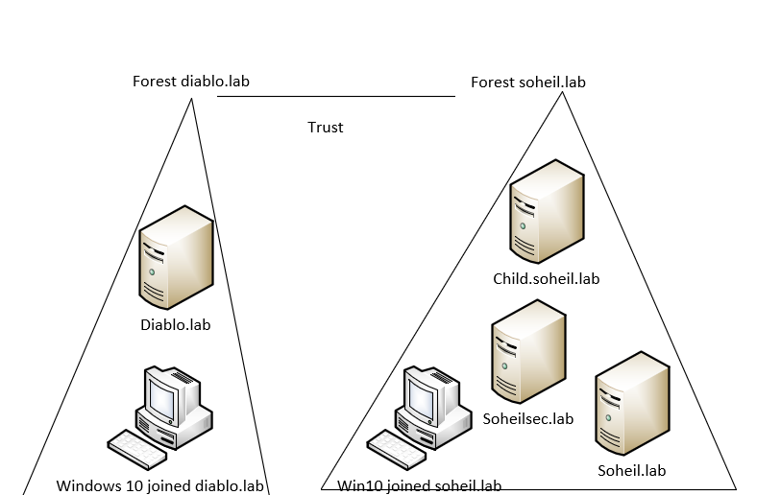
LAB

